Slide 1
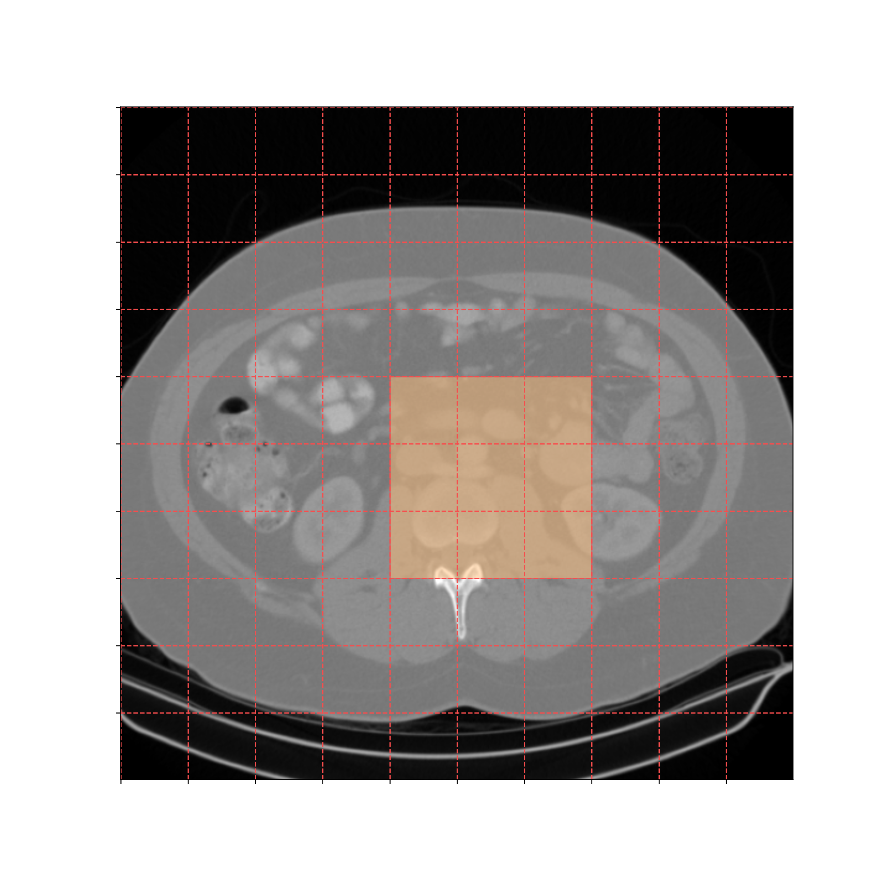
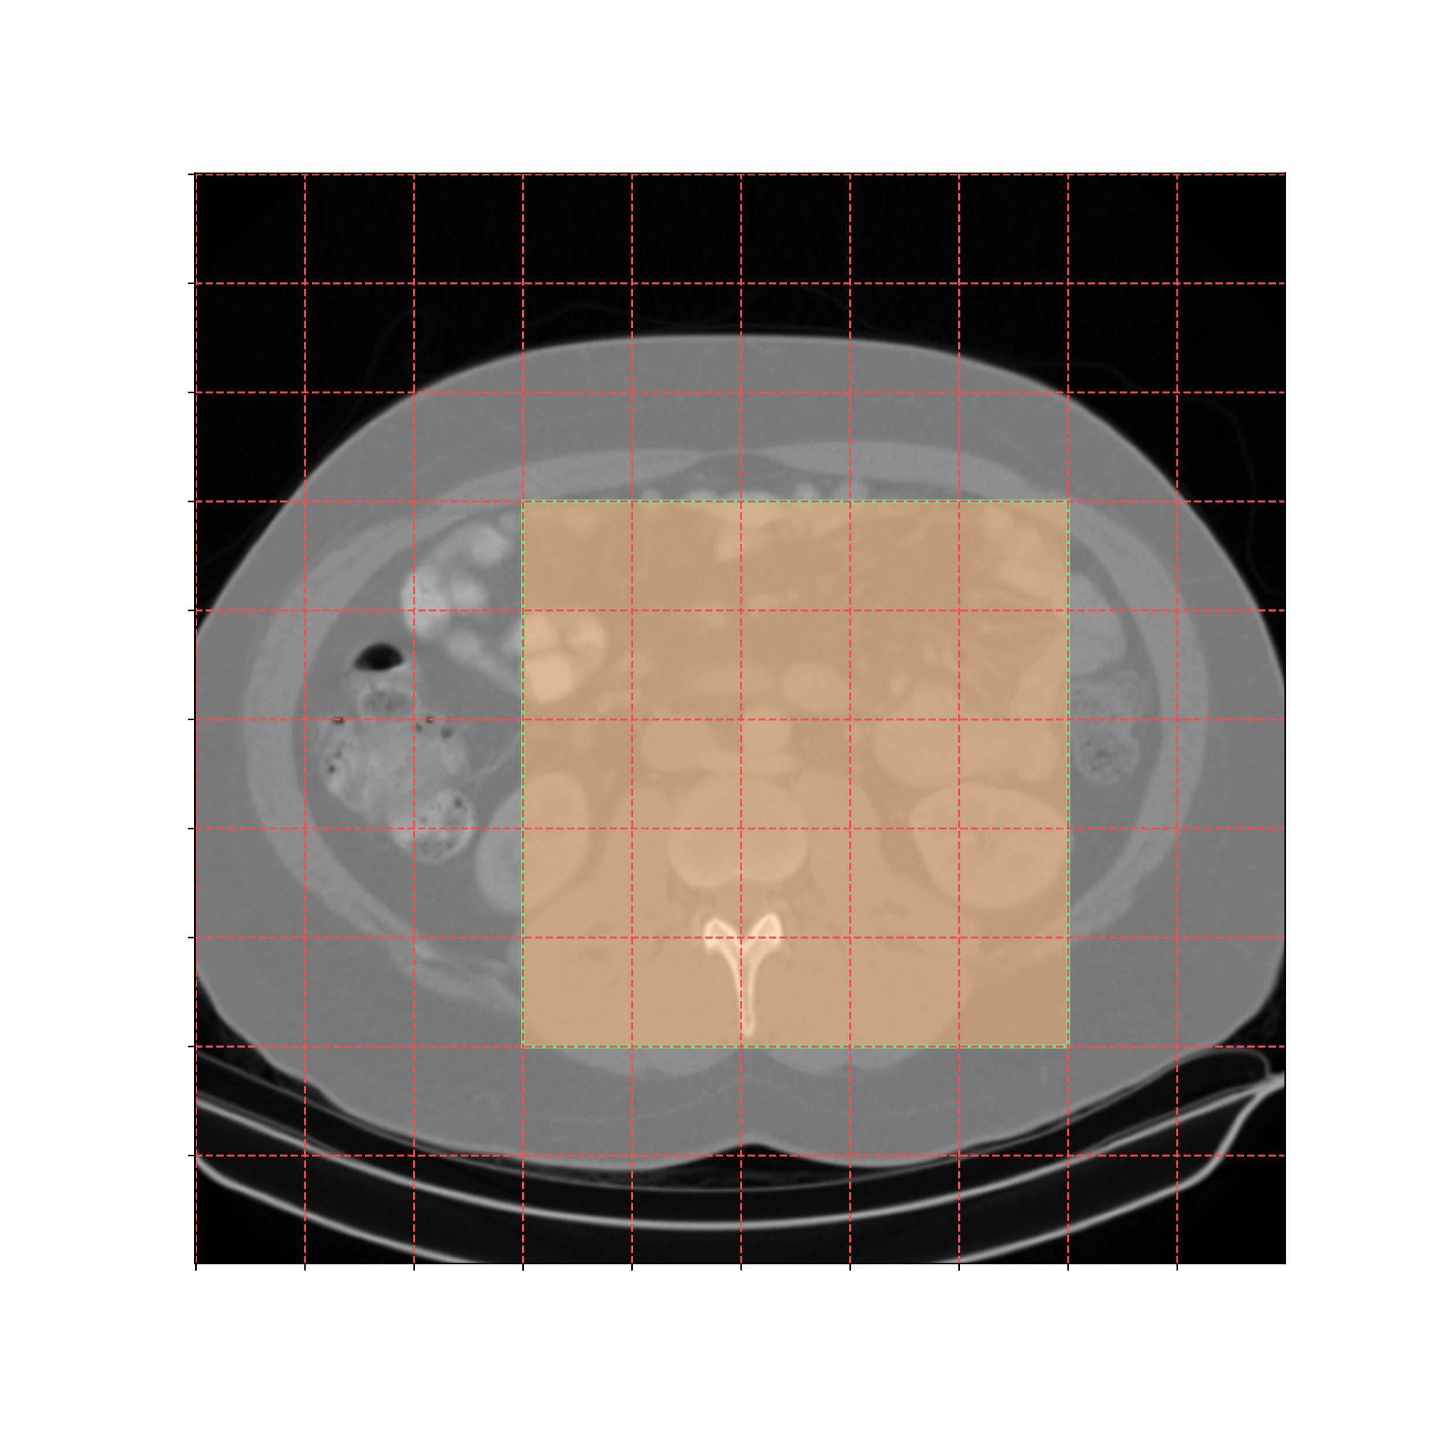
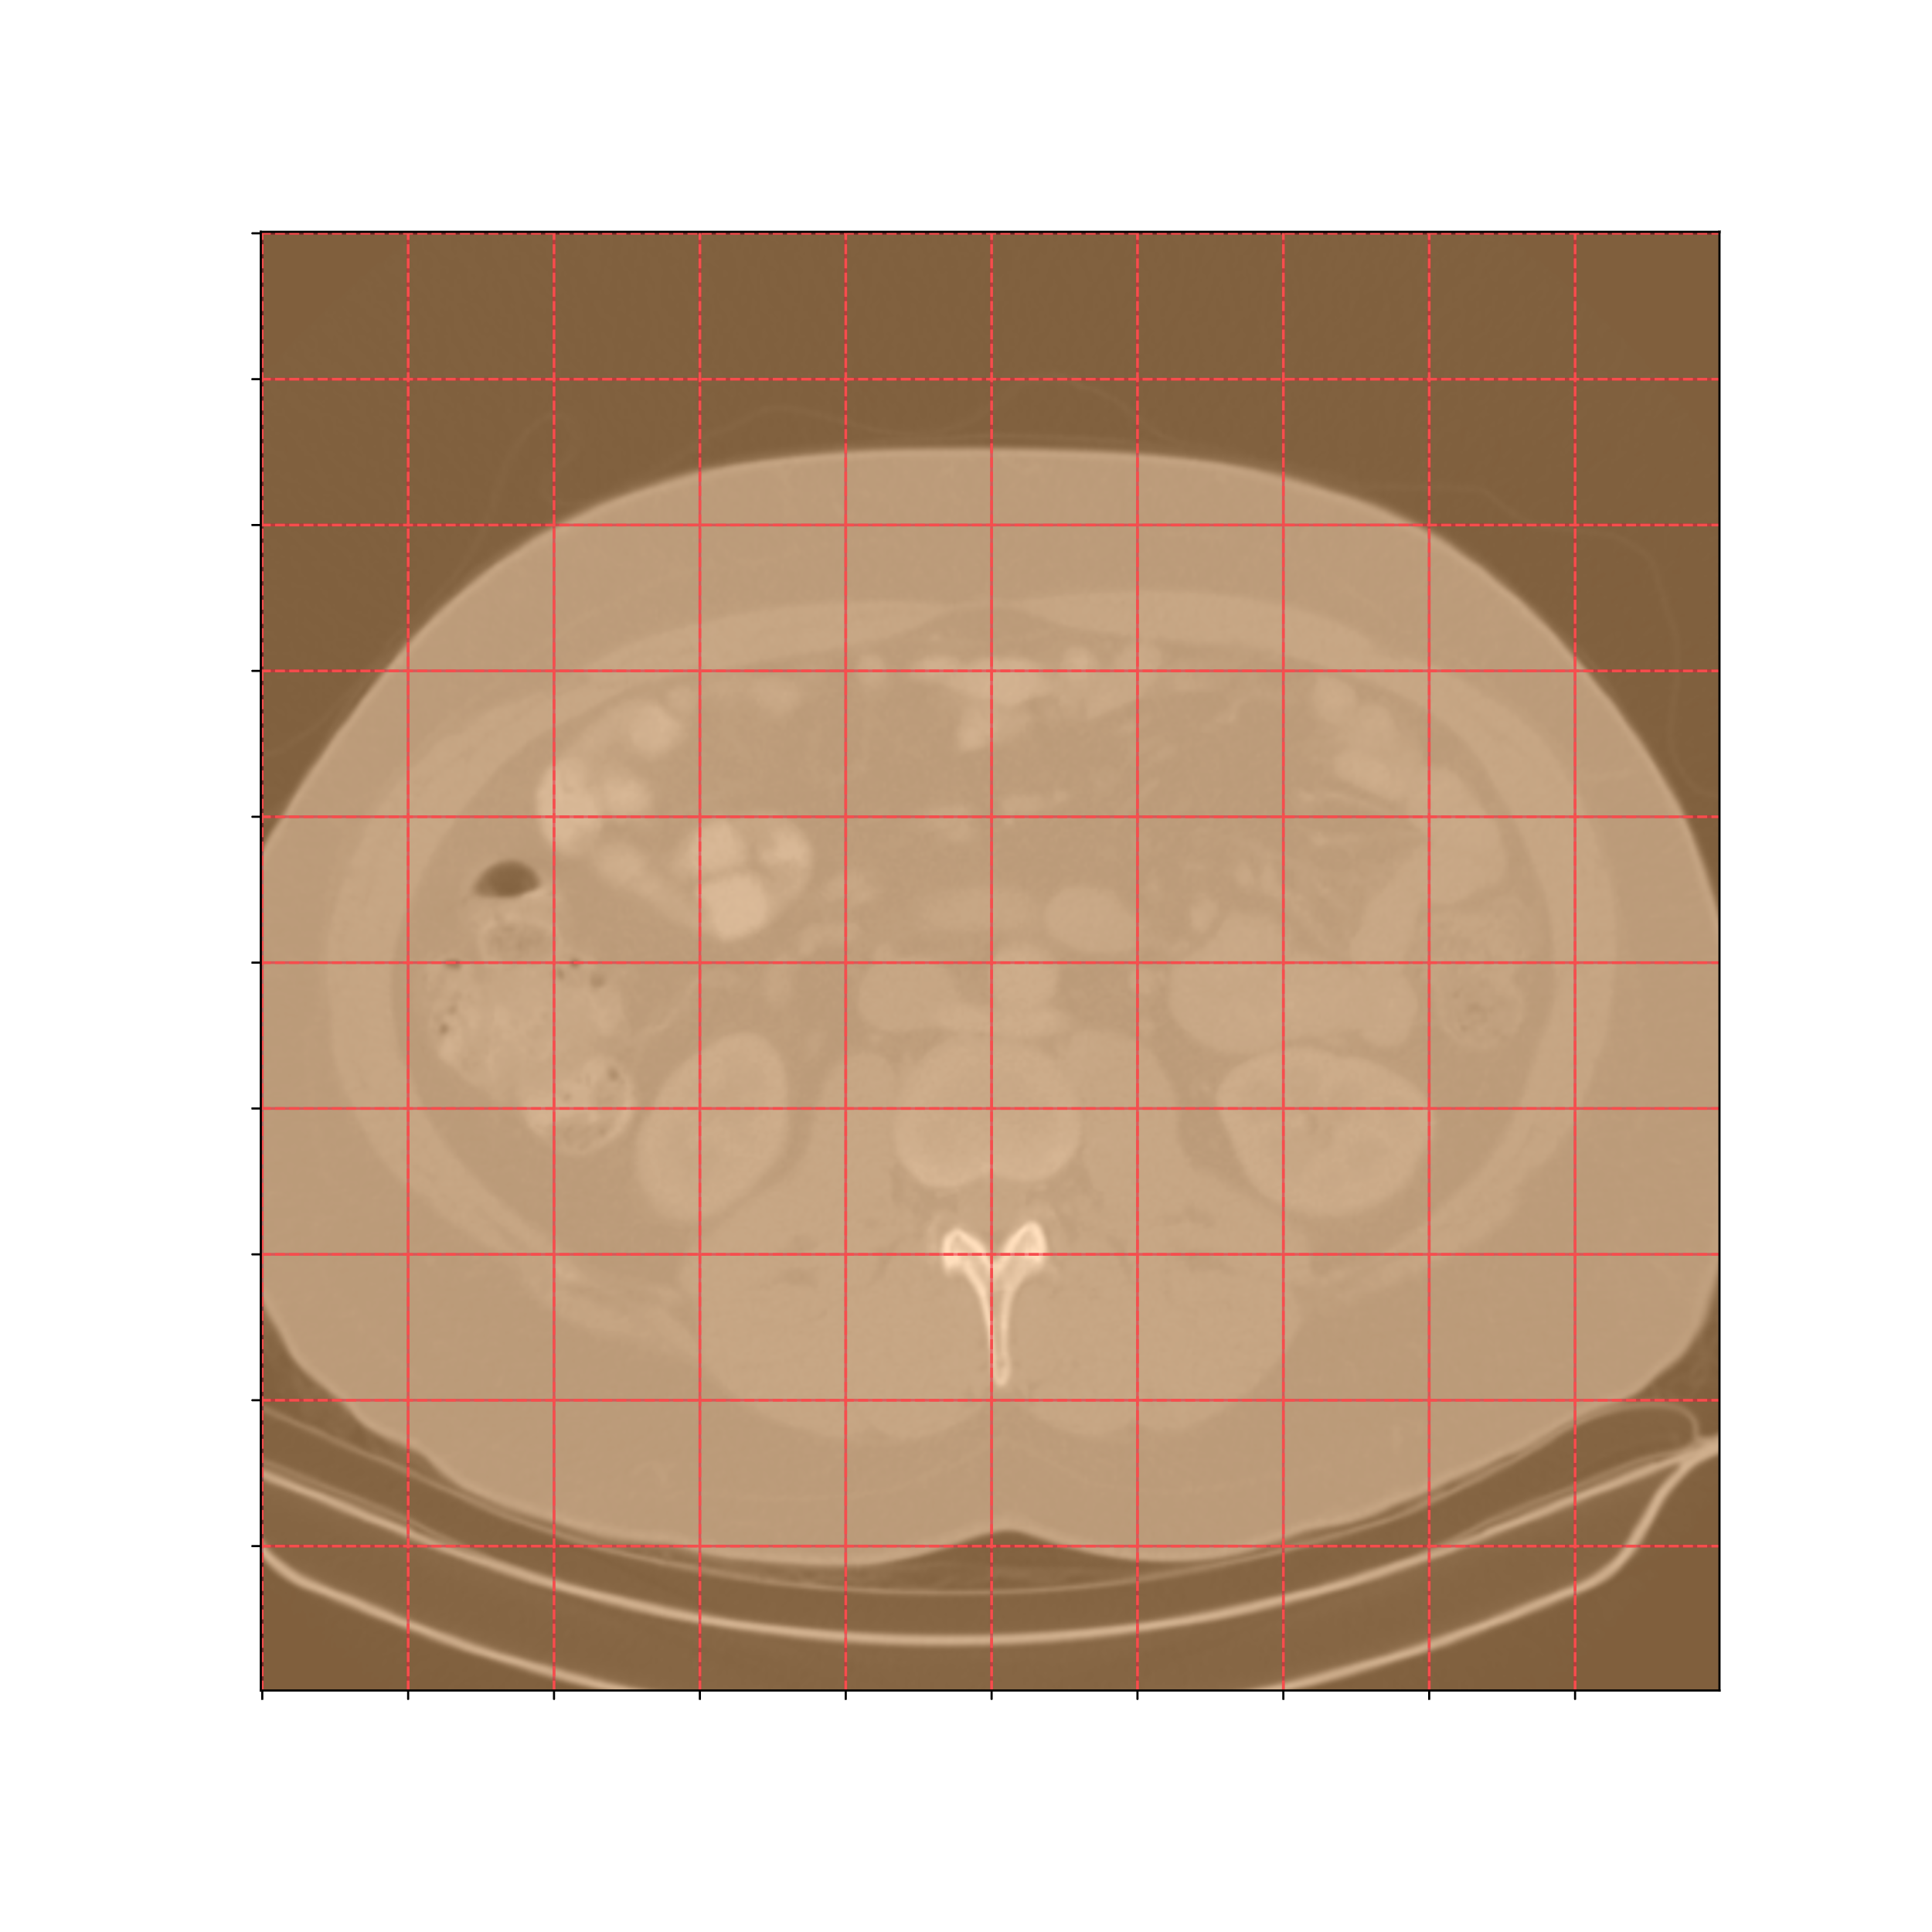
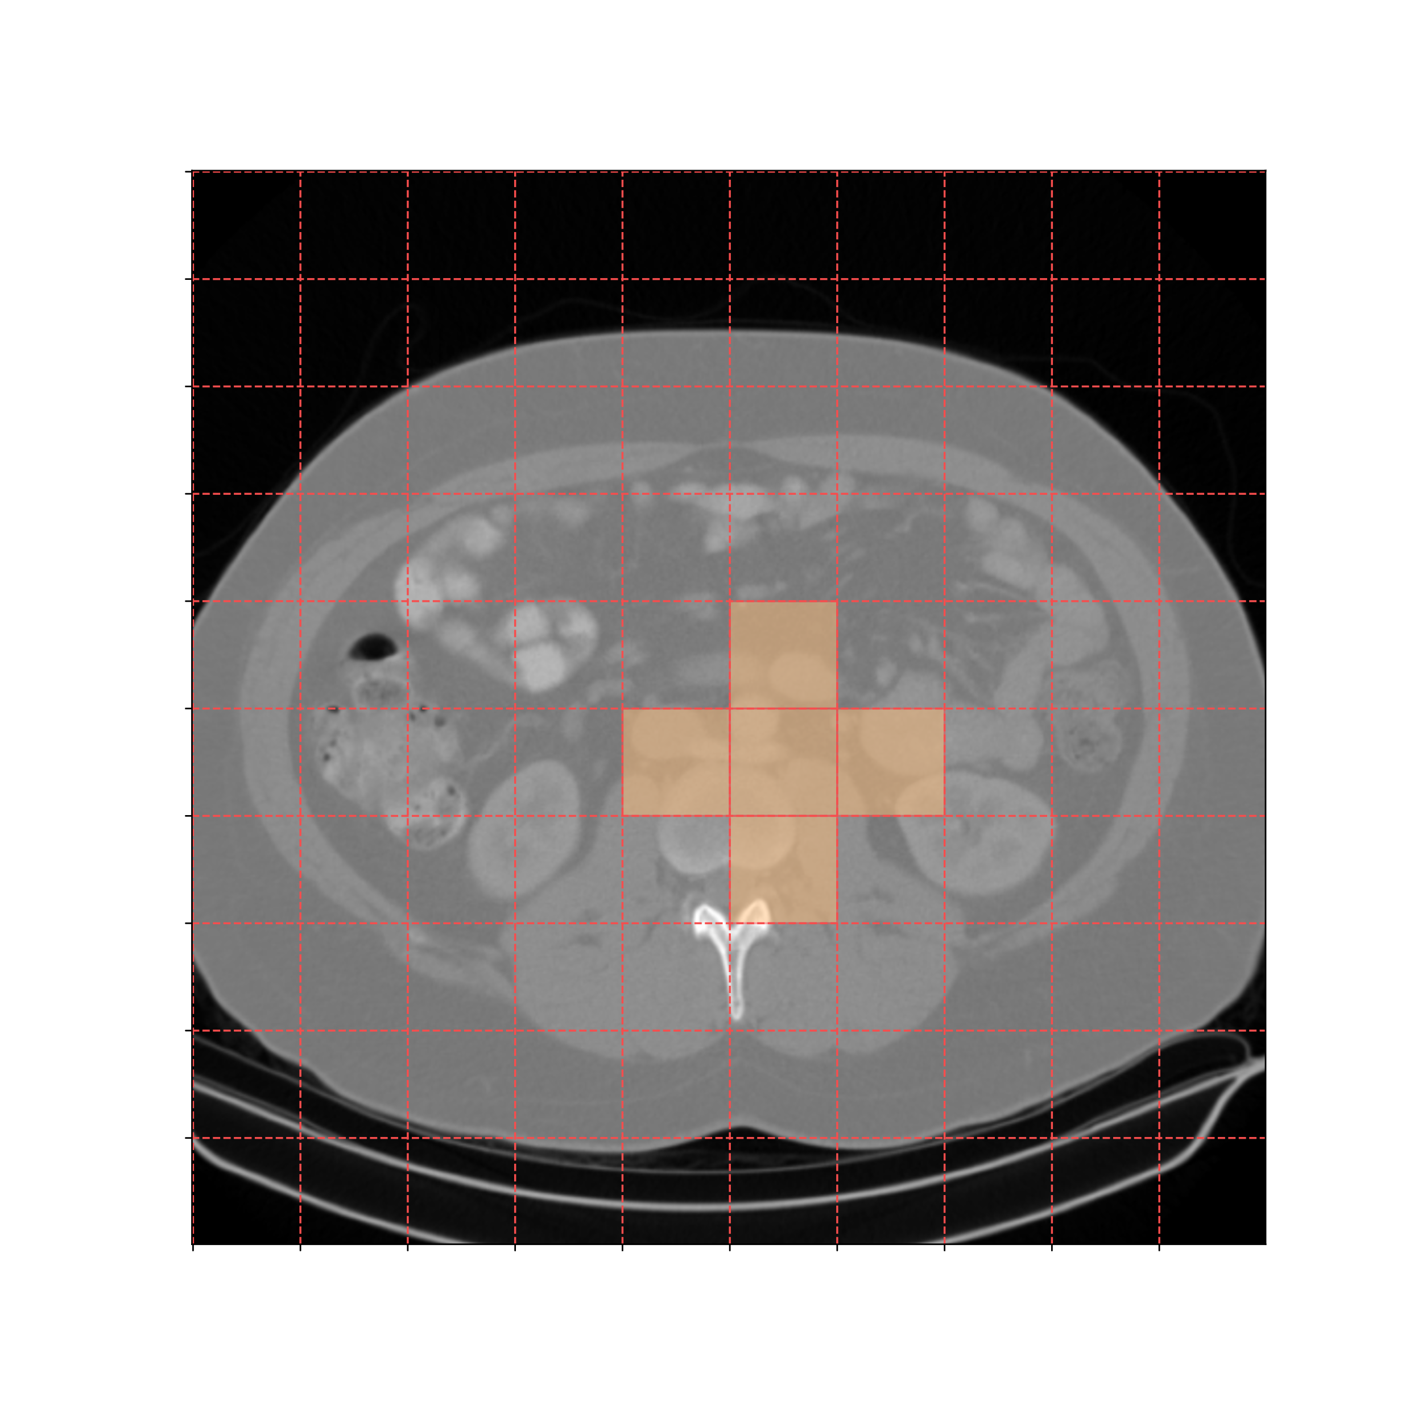
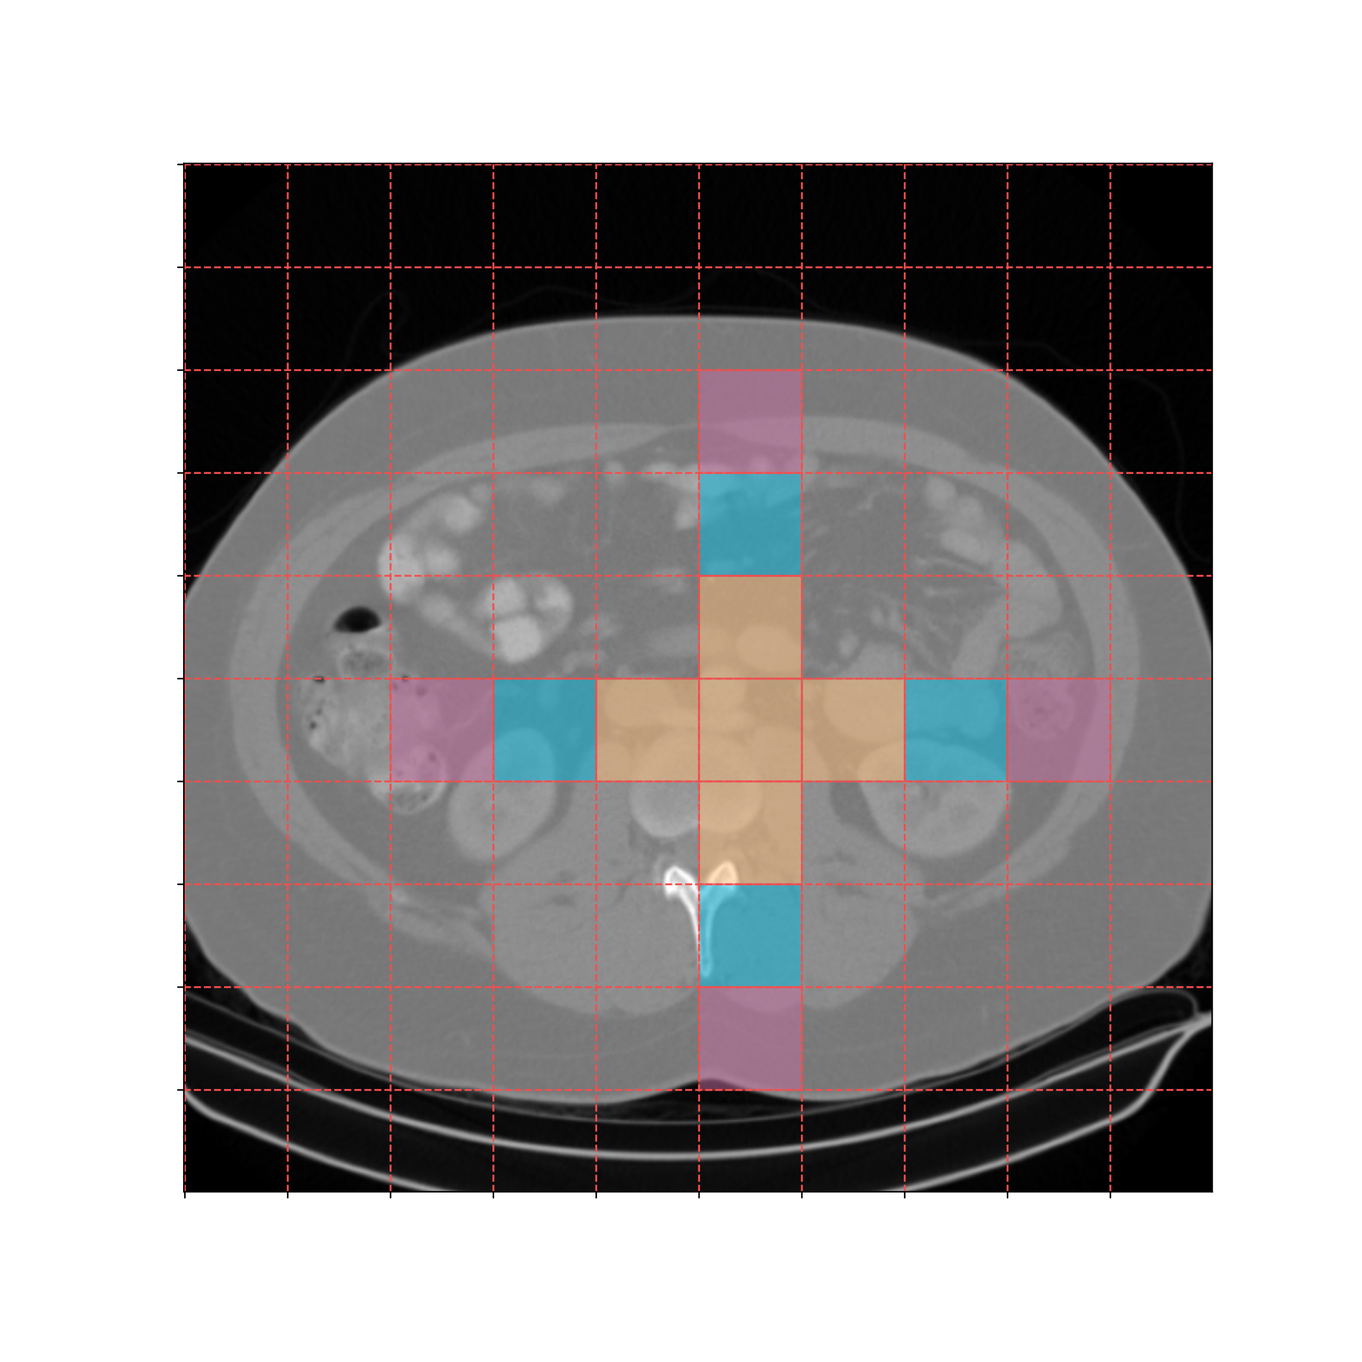
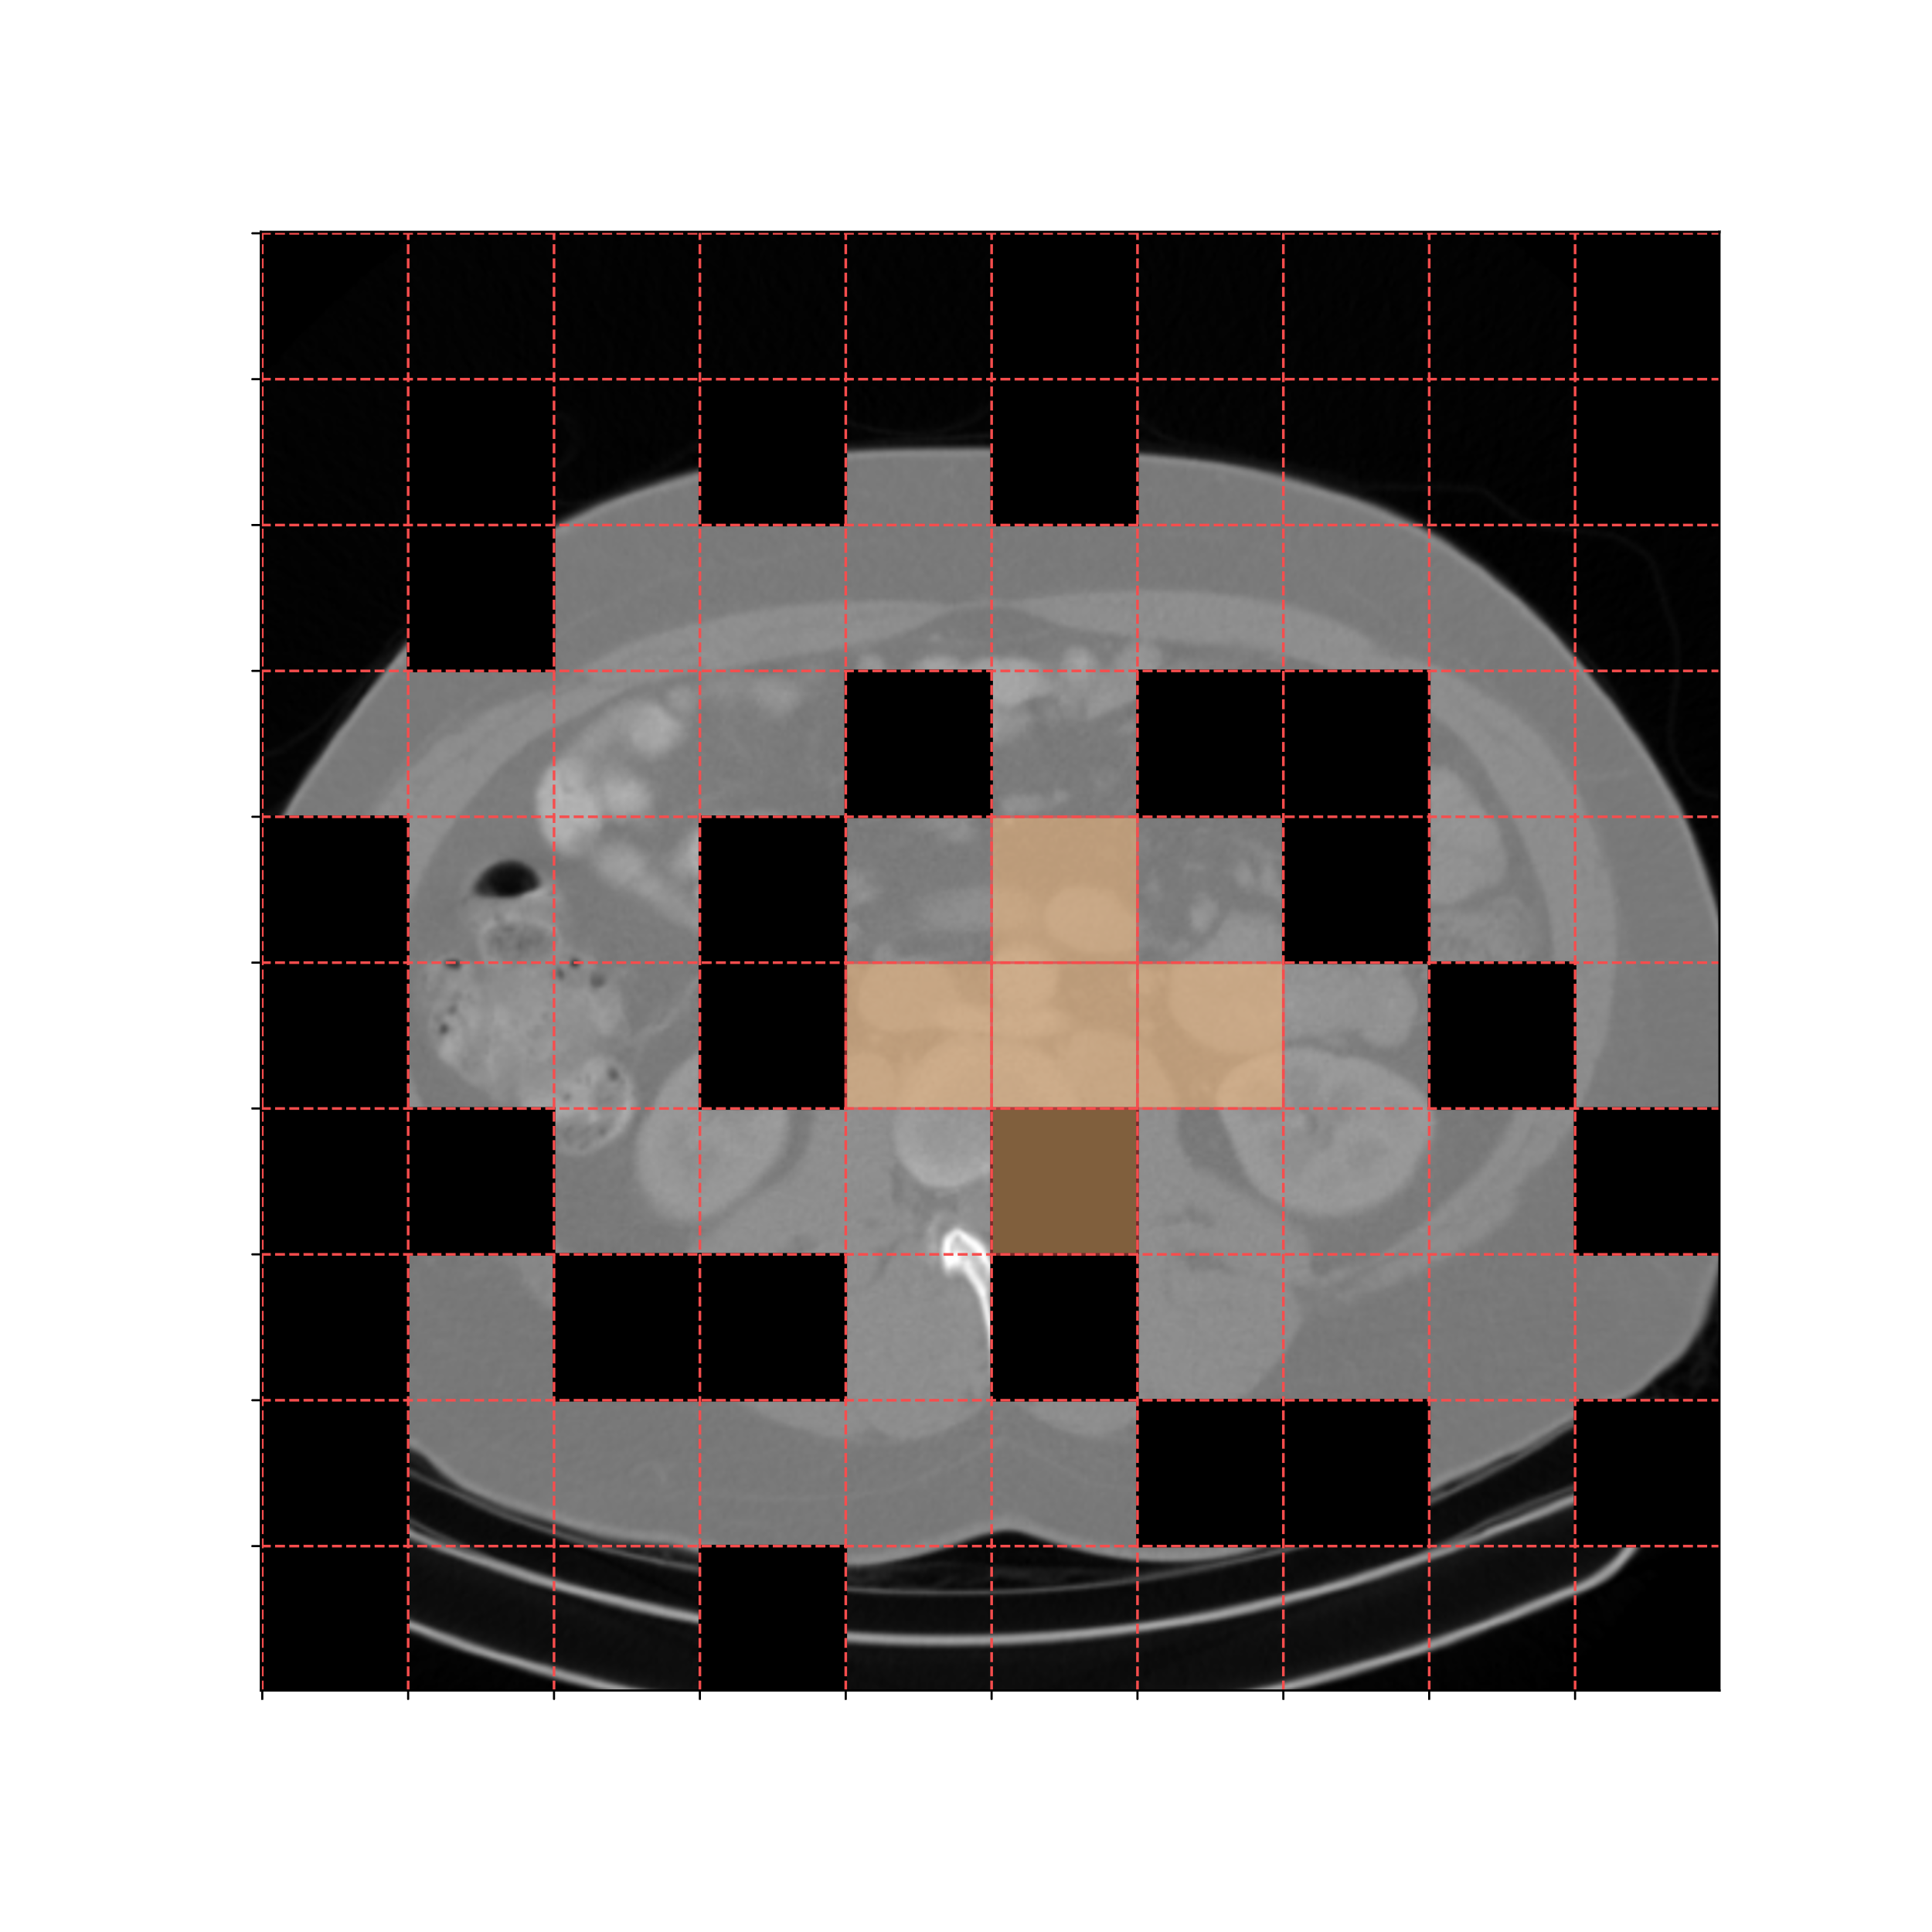
Receptive Field
Swin Window
Receptive Field In Different Scales
Mask
(a) Convolution
(b) Swin Transformer
(c) MLP-Mixer
(d1) Axial Permute
(d2) Multi-scale Axial
Permute
(d3) Masked Axial Permute
Ours

